Slide 1
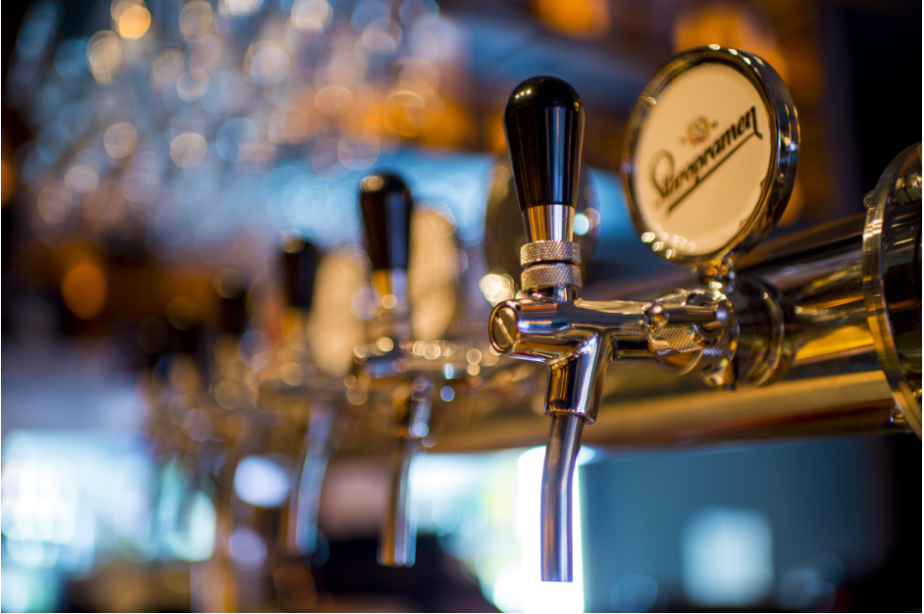
SQL CHALLENGE 5
Pub Pricing Analysis

Slide 2
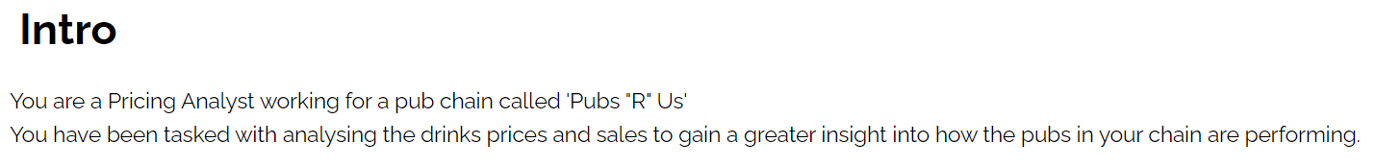

Slide 3
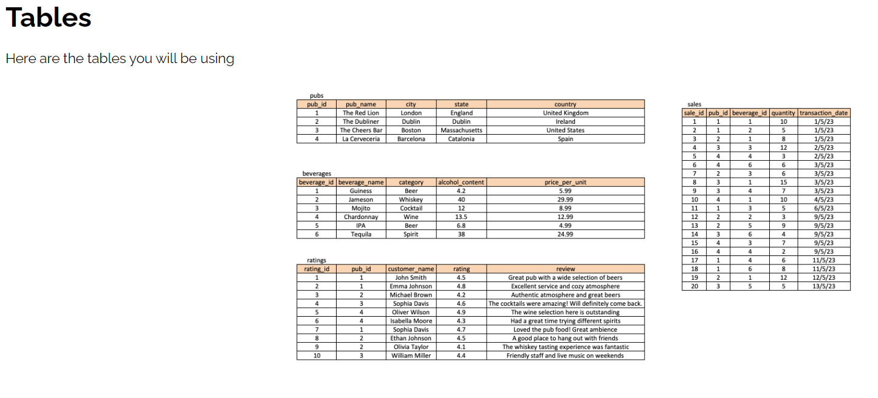

Slide 4
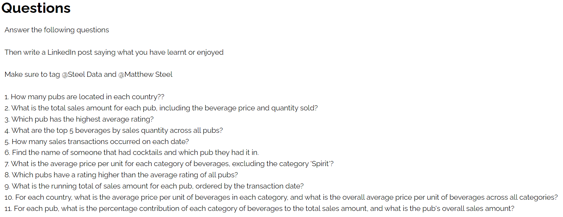

Slide 5
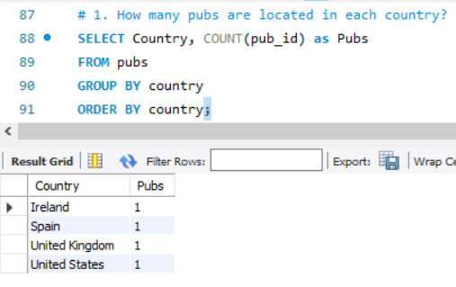

Slide 6
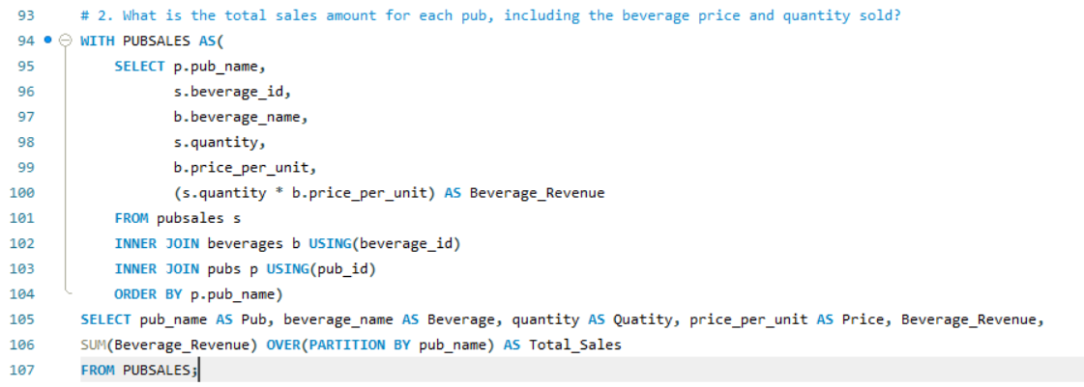
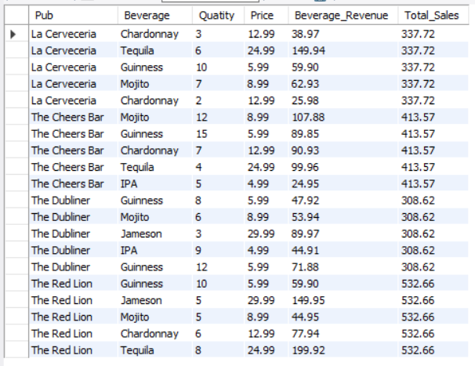

Slide 7
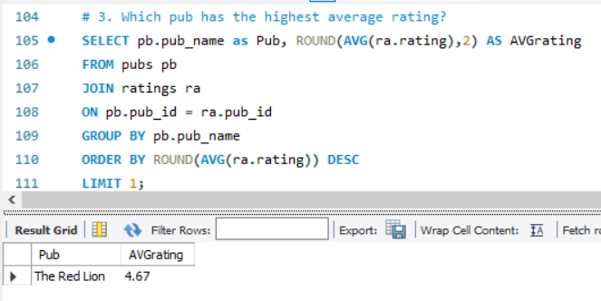

Slide 8
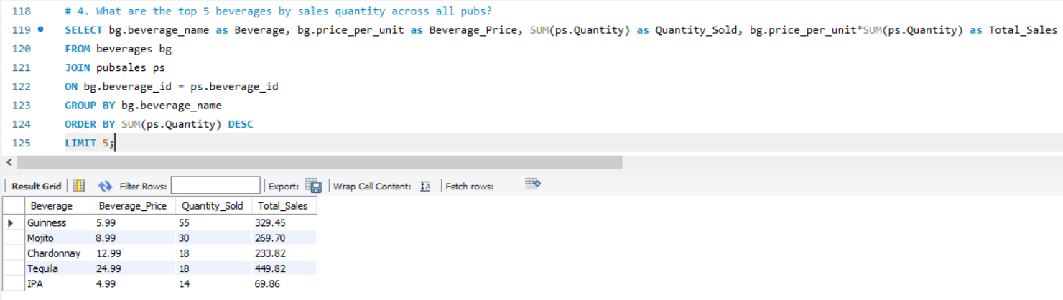

Slide 9
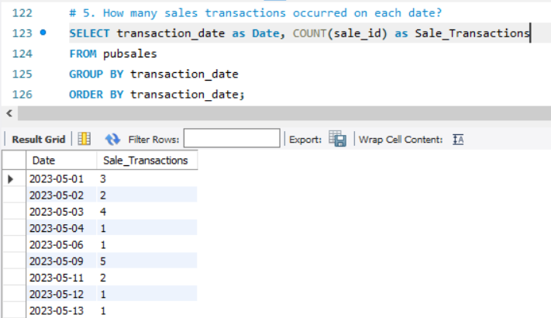

Slide 10
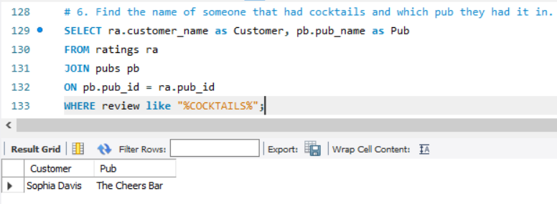

Slide 11
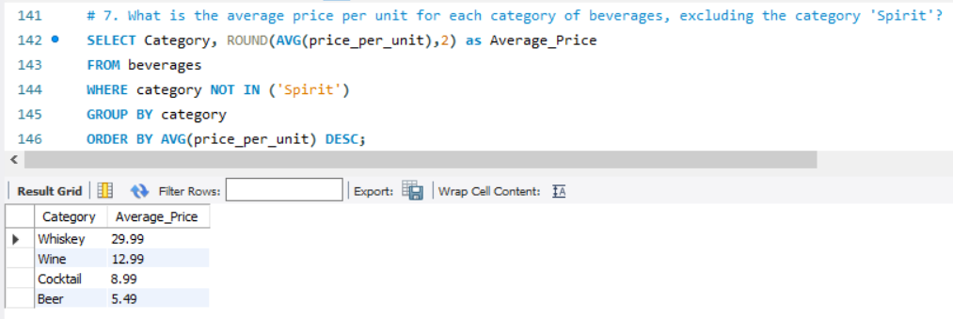

Slide 12
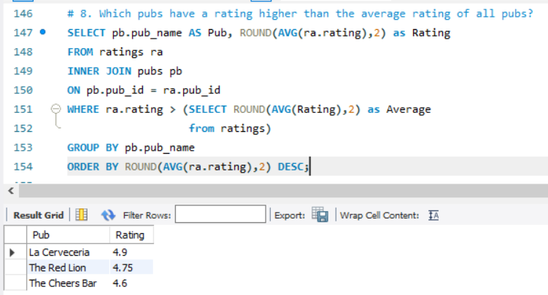

Slide 13
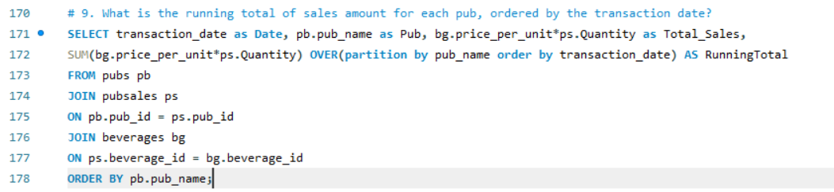
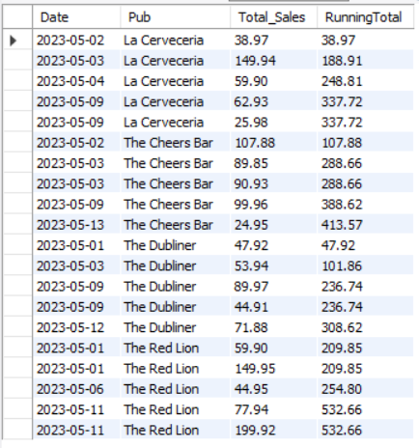

Slide 14
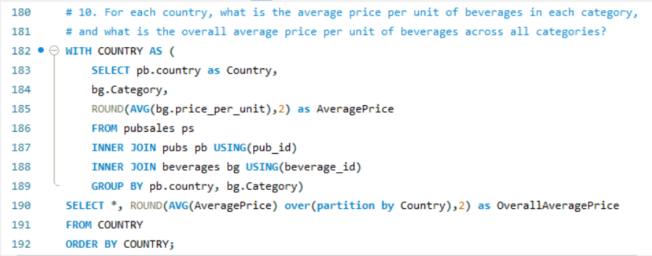
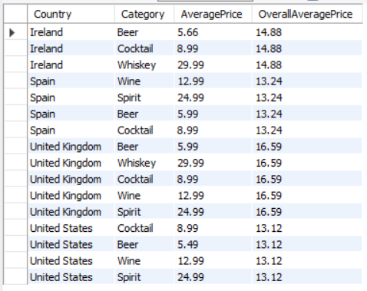

Slide 15
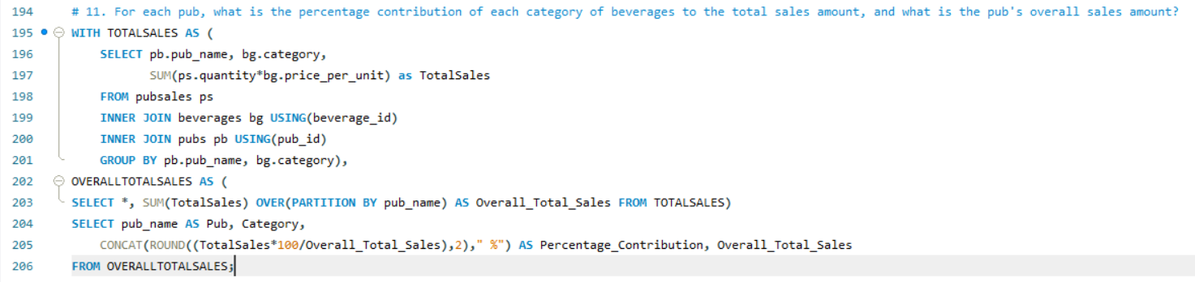
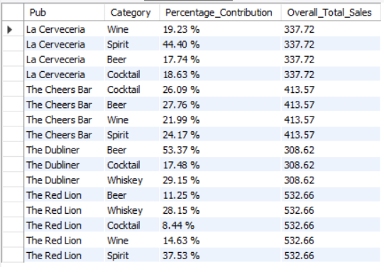

Slide 16
INSIGHTS
Pubs are located in four countries.
The red lion was the pub with the highest sales registered, whereas the cheers bar was the one where most quantity of products were sold.
Tequila was the most sold product followed by Guinness beer.
Three pubs were above the average rating.
Whiskey happened to registered the highest average price compared to beer which had the lowest average price of the products.
On may 9th was the date where most of the transactions took place.
The percentage contribution of each beverage varies from pub to pub.

